Slide 1
Online Art Gallery
KL-Y22
Section - 22
Team-26

Slide 2


Team Members
A
ID Name
2200030032 B. Sai Navadeep
2200030049 S. Sanjeev
2200030218 Sharmila Shaik
Team Mentor :-

Slide 3
Online Art Gallery
Conclusion of the Project
Introduction
Introduction to the SDP
Empathy
Express the Feelings
Define
Defing the SDP
High Pedeility
Prototype
Conclusion

Slide 4
Introduction
The Online Art Gallery is a digital platform designed to serve as a virtual art gallery, showcasing a diverse range of artworks. It aims to bridge the gap between artists and art enthusiasts by providing a curated collection of paintings, sculptures, photographs, digital art, and other forms of visual art. The platform facilitates art sales and transactions, fostering a vibrant online community for art appreciation and acquisition.

Slide 5
Necessity of Online Art Gallery
A
Accessibility
Exposure
Convenience
Community
Global

Slide 6
Online Art Gallery
User Management Module
Exhibition Management Module
Inventory Management Module
Gallery Administration Module
Artwork Catlog Module
Modules of SDP

Slide 7
Empathy
F
Artists feel empowered and supported as they have a platform to exhibit their work and connect with a global audience, enhancing their visibility and opportunities for recognition.
Art enthusiasts experience greater accessibility and convenience in discovering and acquiring artworks that resonate with them, enriching their personal collections and fostering a deeper appreciation for art.
The Online Art Gallery cultivates a sense of community among artists and art enthusiasts, facilitating interactions, collaborations, and discussions around art, thereby enriching the overall cultural landscape.

Slide 8
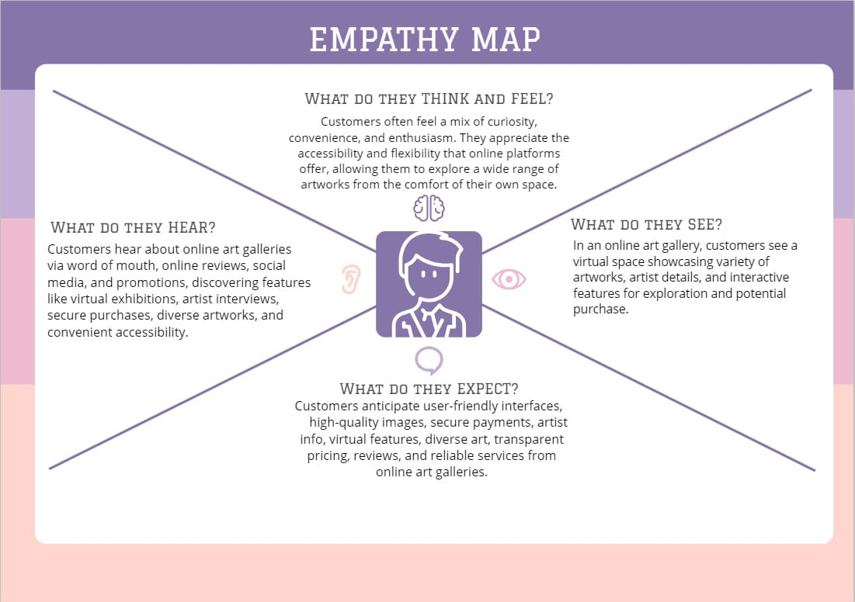
Empathy Map

Slide 9
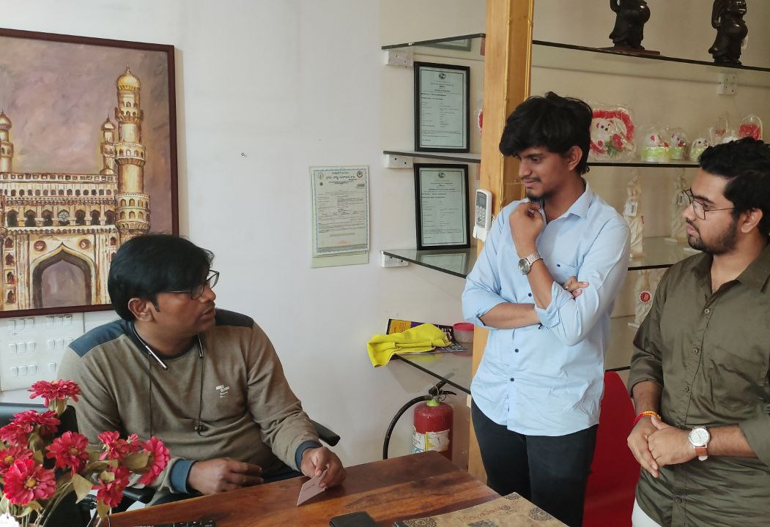
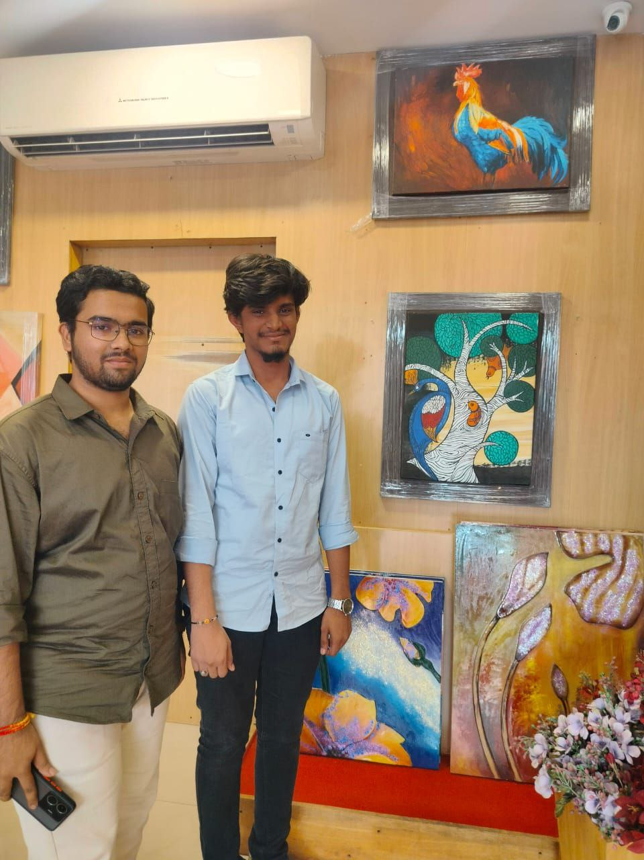

Empathy Interview

Slide 10
Empathy Interview Questions
How Often did a customer visit the art gallery?
How does the Online Art Gallery differentiate itself from traditional art galleries
How do you attract and curate a diverse range of artworks and artists on the Online Art Gallery?
How do you handle transactions and ensure a secure online purchasing experience for users
Empathy Interview link:https://drive.google.com/file/d/1ASG2s5SZFqvcnMgwmpVseLSlPP6rceK/view?usp=sharing

Slide 11
Question Asked Insights

Slide 12
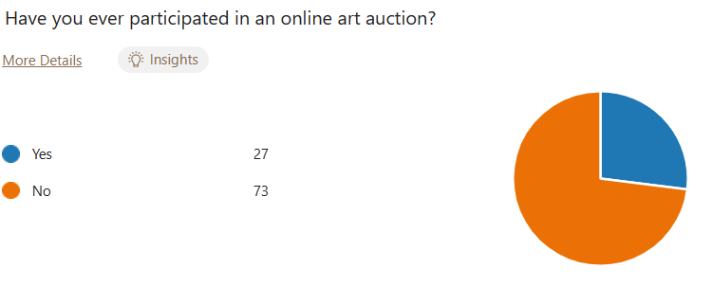
Question Asked Insights

Slide 13
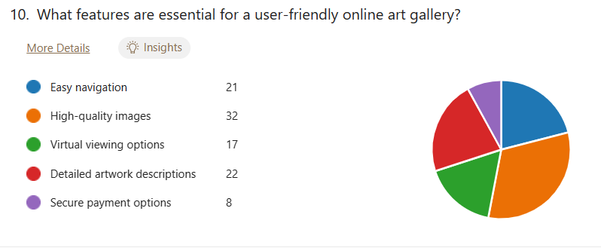
Question Asked Insights

Slide 14
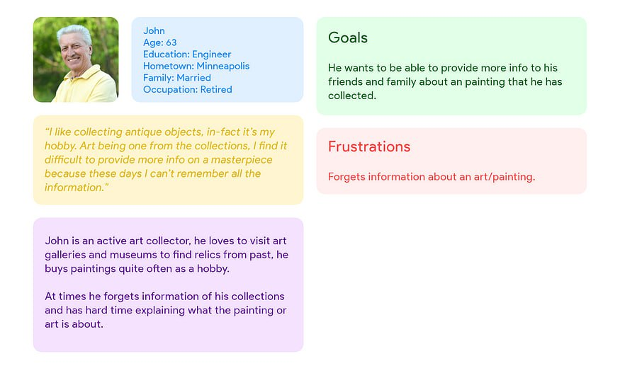
Persona

Slide 15
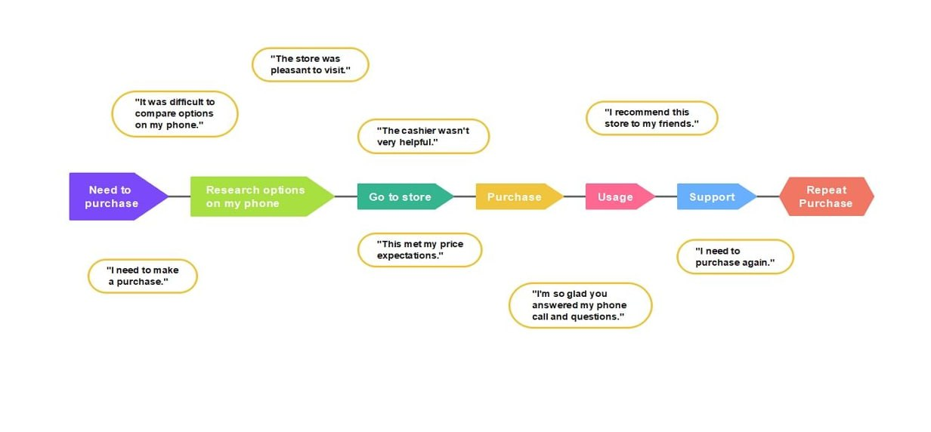
Customer Journey Map

Slide 16
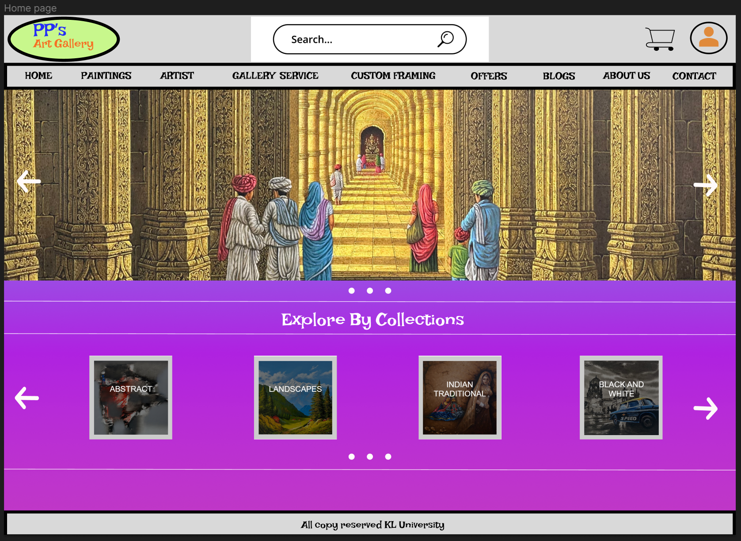
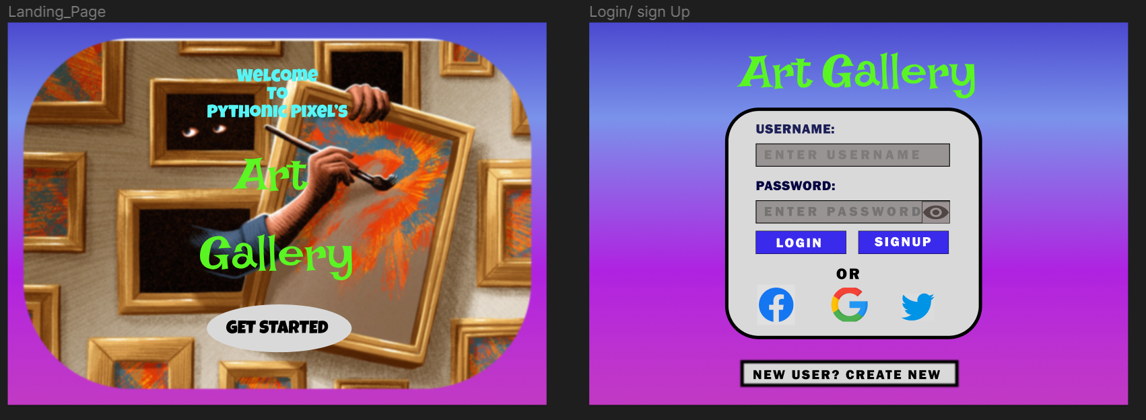
Prototype

Slide 17
Summary
In conclusion, the Online Art Gallery stands as a transformative platform that transcends the boundaries of traditional art galleries, offering a digital space where artists can showcase their creations to a global audience and art enthusiasts can explore and purchase artworks conveniently. By addressing the limitations of physical galleries, the Online Art Gallery promotes accessibility, fosters exposure for emerging artists, and cultivates a vibrant online community centered around art appreciation and acquisition. With its emphasis on convenience, authenticity, and connectivity, the platform serves as a testament to the evolving landscape of art in the digital age, enriching the cultural experience for artists and art lovers alike.

Slide 18
Thank you
By
Team Lead : Sharmila
Navadeep
Sanjeev
Team-26
From Section -22

